Slide 1
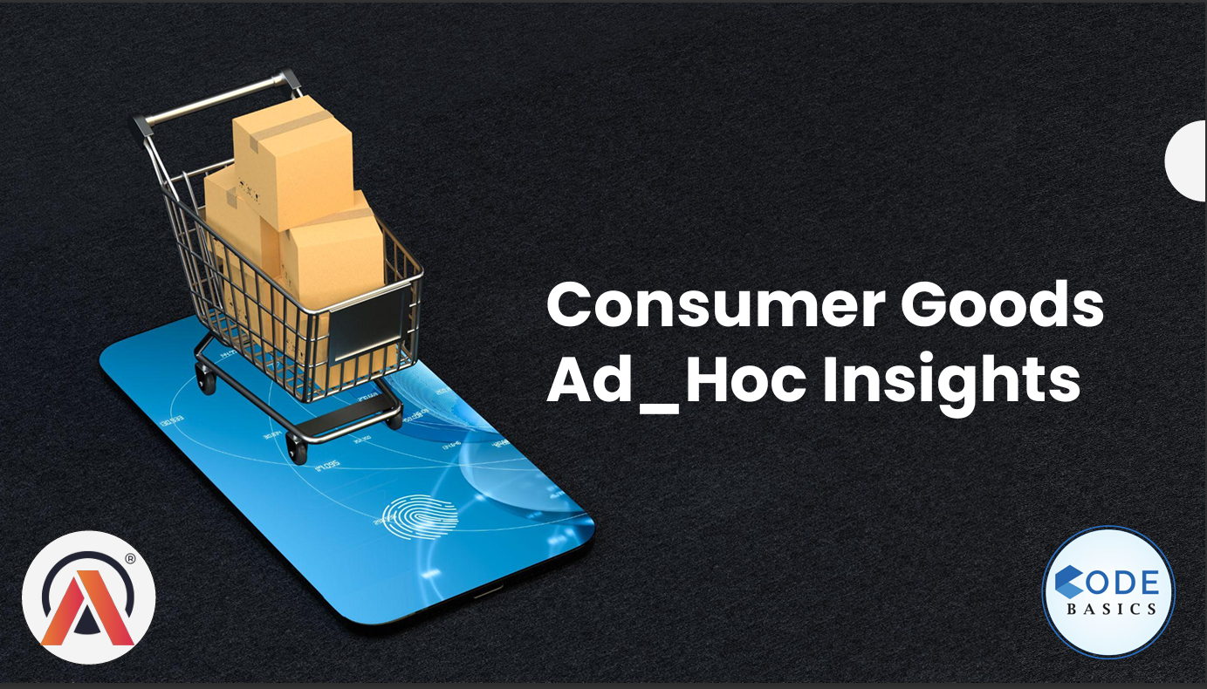

Presented by : Ruchi Wange
Presented by : Ruchi Wange

Slide 2
Role of Ad Hoc Consumer Insights:
🔹 Key Roles
Quick Decision Making – Provides immediate answers to urgent business questions.
Targeted Problem Solving – Focuses on specific issues (e.g., campaign or product feature feedback).
Consumer Behaviour Understanding – Captures real-time shifts in customer preferences & attitudes.
Campaign Evaluation – Measures the effectiveness of promotions, ads, or product launches.
Flexibility & Customization – Research tailored to unique business needs and niche segments
Risk Reduction – Tests consumer response before large-scale investments.
Competitive Edge – Enables faster response to market trends than competitors.

Slide 3
Methodologies and Tools:
Online Surveys & Polls – Quick, scalable feedback collection.
Focus Groups / Interviews – In-depth understanding of consumer opinions.
Social Media Listening – Tracking conversations, sentiment & trends.
A/B Testing – Comparing variations to see what works best.
Customer Feedback Forms – Direct input from users at touchpoints.
Analytics Dashboards – Real-time insights from sales, web & app data.
Mobile Research Apps – Instant feedback through consumer devices.
Observation / Field Studies – Spotting actual consumer behavior.

Slide 4
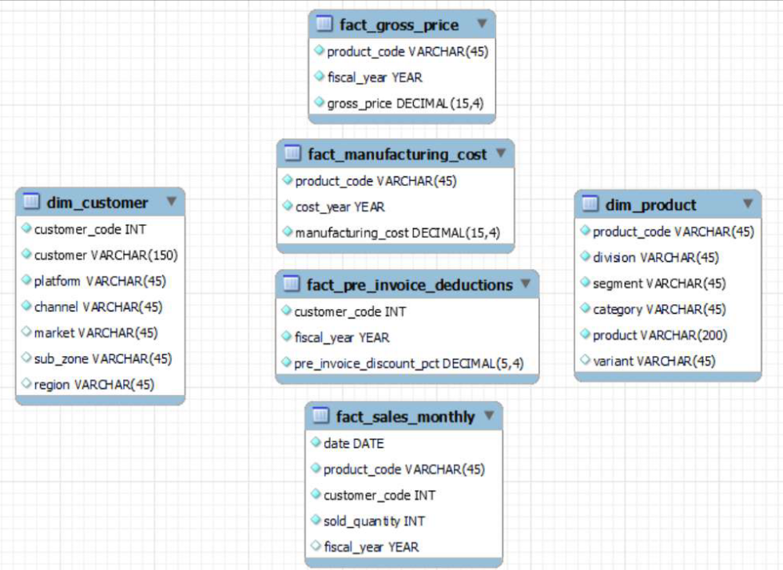
Input Data :

Slide 5
🎯 Project Objectives – Ad Hoc Consumer Insights
Understand Business Context Gain insights into consumer perception and purchasing behaviour of AtliQ Hardware products.
Solve a Specific Business Challenge Provide targeted, ad hoc analysis as proposed in the project challenge designed by Tony Sharma.
Generate Actionable Insights Deliver quick, data-driven recommendations to support AtliQ Hardware’s strategic decisions.
Evaluate Consumer Preferences Identify key drivers influencing product adoption, satisfaction, and loyalty.
Support Marketing & Sales Teams Enable evidence-based decisions for campaign effectiveness, pricing, and product positioning.
Develop Analytical Skills Apply data analytics concepts from the course to a real-world business scenario.
Bridge Learning & Practice Translate classroom learning into a practical project aligned with industry challenges.

Slide 6
🚀 Project Deliverables:
Addressed 10 Ad Hoc Client Requests
SQL Queries → Extracted & prepared business data
Visualizations → Built clear, interactive dashboards
Insights → Converted results into actionable recommendations
Ensured data-driven decision support for AtliQ Hardware
Outcome of the Project:
Successfully solved 10 business challenges for the client
Combined querying, visualization & insights for end-to-end solutions
Delivered practical, data-backed answers to support management
Enhanced understanding of consumer behavior & business trends
Strengthened analytical & problem-solving skills through real-world case application

Slide 7
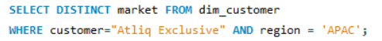
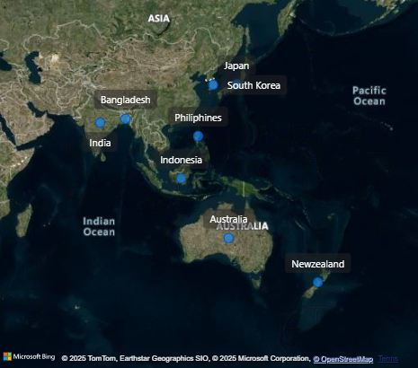
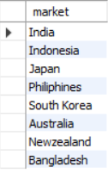
Request 1 :
Provide the list of markets in which customer "Atliq Exclusive" operates it business in the APAC region.
SQL Query:
Insight:
Query output:

Slide 8
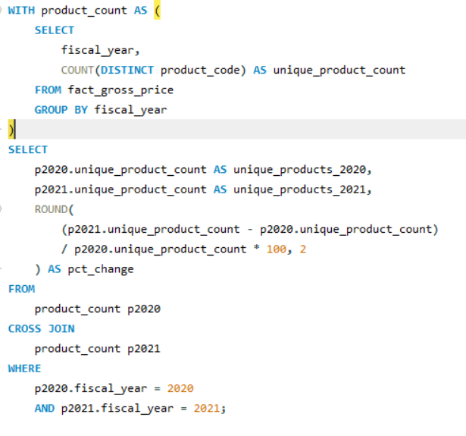
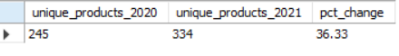
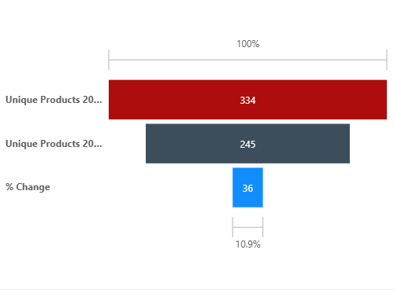
Request 2 :
What is the percentage of unique product increase in 2021 vs. 2020? The final output contains these fields:
unique_products_2020 ,unique_products_2021, percentage_change.
SQL Query:
Query output:
Insight:

Slide 9
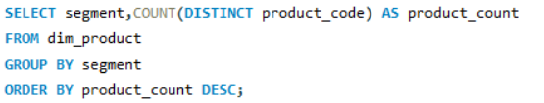
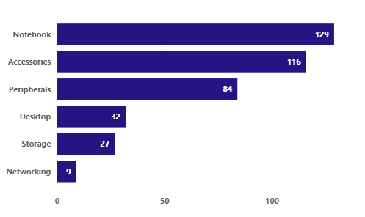
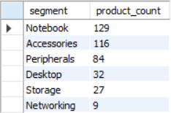
Request 3:
Provide a report with all the unique product counts for each segment and sort them in descending order of product counts. The final output contains 2 fields, segment product_count
SQL Query:
Insight:
Query output:

Slide 10
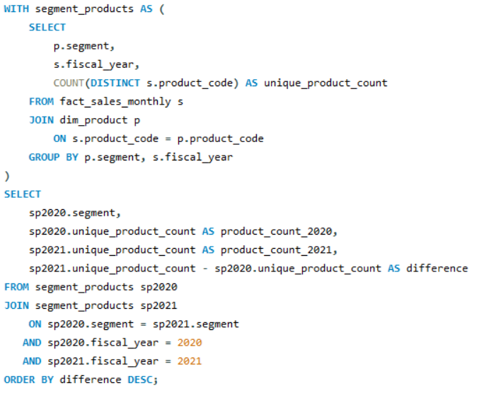
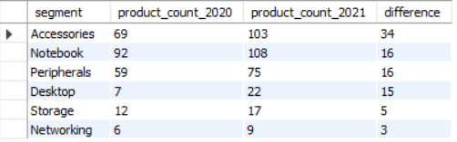
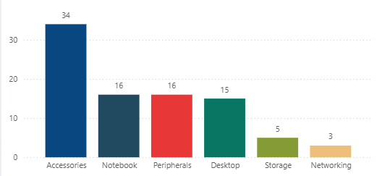
Request 4 :
Follow-up:
Which segment had the most increase in unique products in 2021 vs 2020? The final output contains these fields, segment product_count_2020 product_count_2021 difference
SQL Query:
Query output
Insight

Slide 11
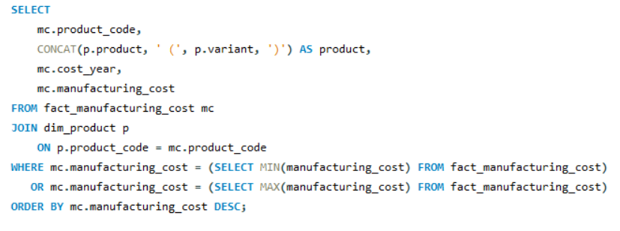
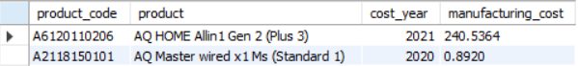
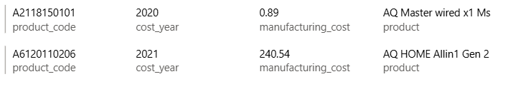
Request 5 :
Get the products that have the highest and lowest manufacturing costs. The final output should contain these fields, product_code product manufacturing_cost
SQL Query:
Query output:
Insight:

Slide 12
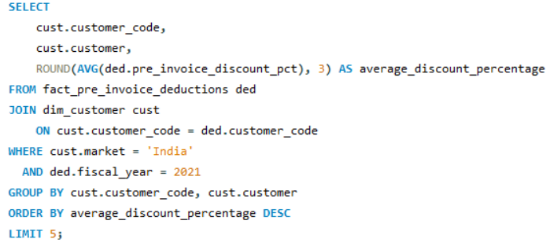
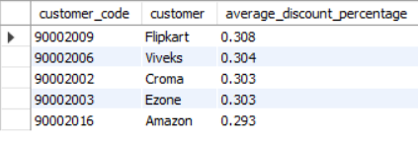
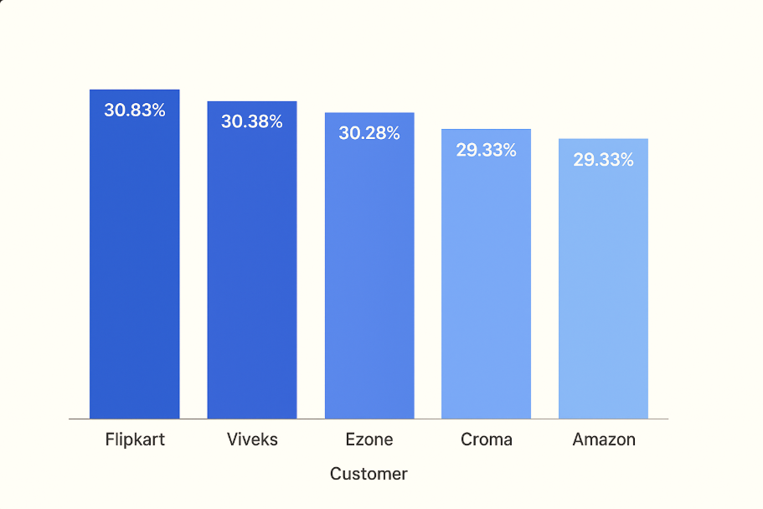
Request 6:
Generate a report which contains the top 5 customers who received an average high pre_invoice_discount_pct for the fiscal year 2021 and in the Indian market. The final output contains these fields, customer_code customer average_discount_percentage
SQL Query:
Insight:
Query output

Slide 13
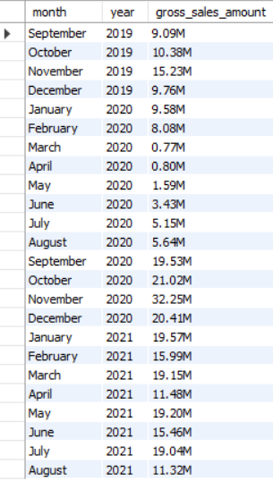
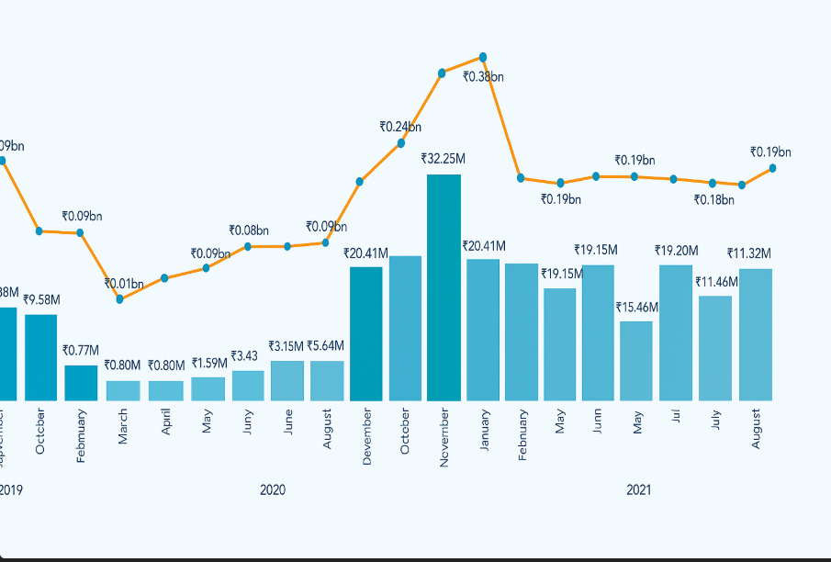
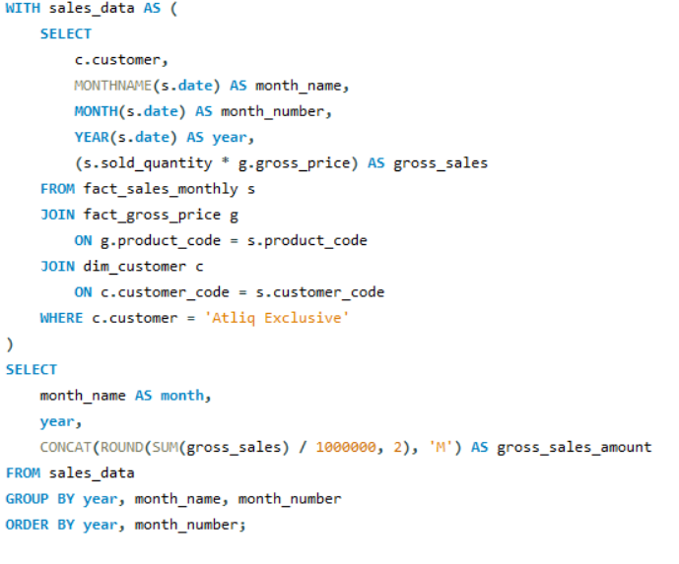
Request 7 :
Get the complete report of the Gross sales amount for the customer “Atliq Exclusive” for each month . This analysis helps to get an idea of low and high-performing months and take strategic decisions. The final report contains these columns: Month Year Gross sales Amount
SQL Query:
Query output
Insight:

Slide 14
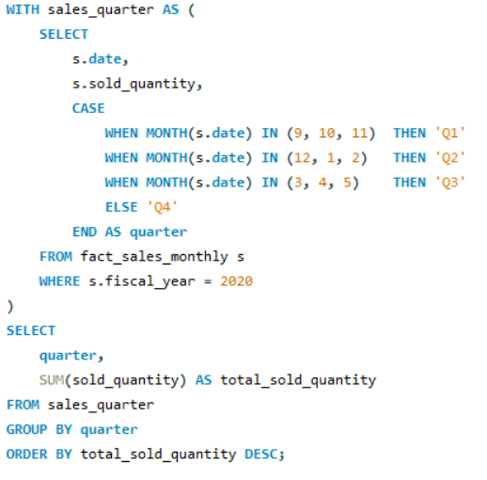
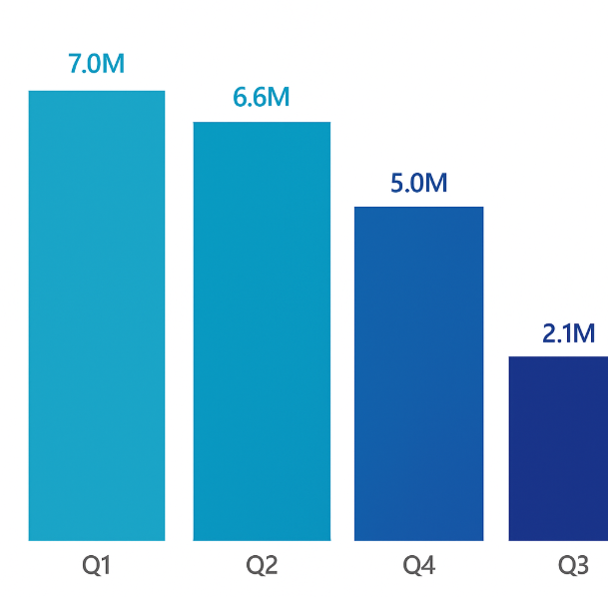
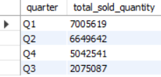
Request 8:
In which quarter of 2020, got the maximum total_sold_quantity? The final output contains these fields sorted by the total_sold_quantity, Quarter total_sold_quantity
SQL Query:
Insight:
Query output

Slide 15
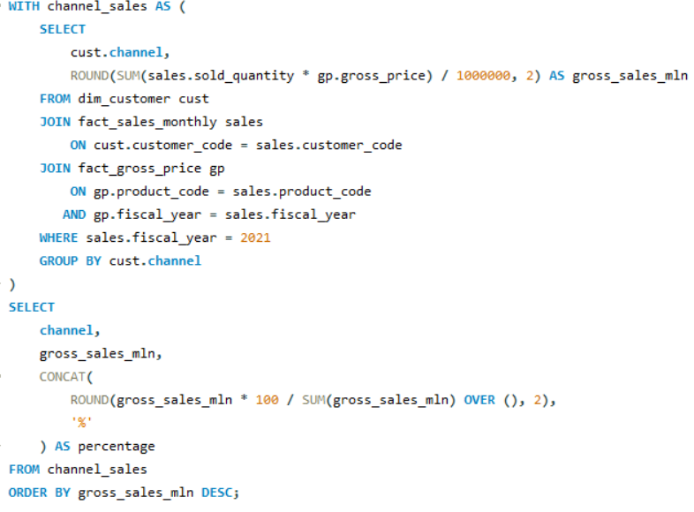
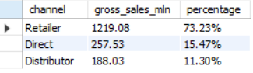
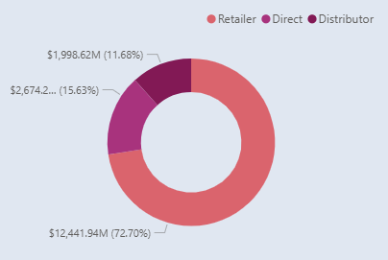
Request 9:
Which channel helped to bring more gross sales in the fiscal year 2021 and the percentage of contribution? The final output contains these fields, channel gross_sales_mln percentage
SQL Query:
Query output
Insight:

Slide 16
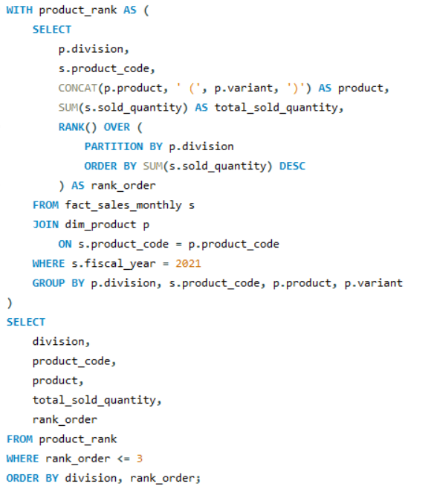
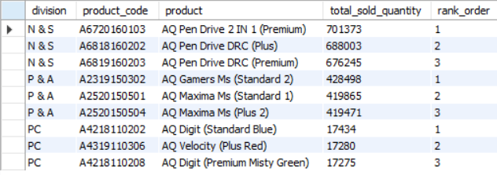
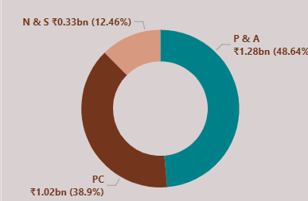
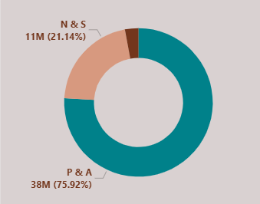
Request 10 :
Get the Top 3 products in each division that have a high total_sold_quantity in the fiscal_year 2021? The final output contains these fields, division product_code ,product total_sold_quantity rank_order
SQL Query:
Query output
Insight 1 :
Insight 2 :

Slide 17
Presented by : Ruchi Wange
THANK YOU!!

